Slide 1





2024
Syarah
How suitable is the price of your used car?
Rahmad Hadi Syafra Demora
rahasyae
Notes:
Hello
My name is Rahmad Hadi Syafra Demora, you can call me Hadi, and I am from Purwadhika DTI DS Batam. in this video, I am excited to present my capstone project for Module 3 on Machine learning and deployment with google cloud program.
In this project, I made a machine learning model on the dataset 'saudi arabia used cars syarah.com' for predict the price of new stock used car price.
so, *How suitable is the price of your used car?*
Syarah is a Saudi Arabian company specializing in selling guaranteed used and new cars online, offering a seamless and convenient buying experience with home delivery and comprehensive warranties.

Slide 2

Outline
1
2
3
BUSINESS
DATA PREPARATION
MODELLING
Background, business problem, goals, and analytic.
Data cleaning, add feature, and feature selection.
Feature engineering, benchmarking, and tuning.
4
5
6
EVALUATION
DEPLOYMENT
OUTPUT
Performance, visualize, and feature importance.
Prediction with Google Cloud Platform
Model business, insight, and recommendation

Slide 3

1 /
1
BUSINESS

Slide 4

1 / Business
Syarah is a Saudi Arabian company specializing in selling guaranteed used and new cars online, specialize on selling used cars from relatively recent or modern years of manufacture. offering a seamless and convenient buying experience with home delivery and comprehensive warranties.
Syarah
cars

Slide 5

“Buy your car with confidence anywhere in Saudi Arabia. Wide selection of new and used cars. Our used cars are inspected & guaranteed with a 10-day refund guarantee.”
Syarah Cars - Saudi Arabia

Slide 6
MISSION AND GOALS
INVESMENT
AWARDS AND RECOGNITION
To modernize the used car market in Saudi Arabia by providing transparent, reliable, and high-quality services, including car evaluations, maintenance, and repair services.
Secured significant investments, 7.5 million SAR in 2018 and 20 million USD in 2021.
The most promising company in the Middle East in 2019 and winning the Startup of the Year award in 2021.
used cars
Saudi Arabia

Slide 7



The Offers
COMPREHENSIVE
INSPECTION
WARRANTY
RETURN POLICY
Used cars are inspected at over 200 points to ensure the quality.
Offer a one-year warranty on used cars.
Customers can return the car within 10 days, in terms and condition.

Slide 8
what we do?
SALES AND VALUATION TEAMS
CAR EVALUATION
CONDITION VERIFICATION
Responsible for pricing new stock used cars
Scoring stock cars to ensure the good quality car
Determining the price of used cars for reasonable price.

Slide 9
some issues?
PROBLEM IN BUSINESS
STRATEGY
EVALUATION
Bias and takes time for pricing new stock good quality used cars based on car type.
Approach involves using regression model to predict car prices. Provide insight into price ranges categorize by car type.
Using Mean Absolute Precentage Error (MAPE) to evaluate the prediction accuracy and easier to interpret.

Slide 10
WHY ML ?
WHY REGRESSION?
HOW IT WORK?
Data driven decision, scalability, automation and cost efficiency.
Designed for predict continuous values such as price, flexibility and interpretable.
Reduces frustration for buyers who encounter overpriced listings and helps sellers price their cars competitively.
why ML ?
Regression
Models

Slide 11
2 /
2
PREPARATION

Slide 12
2 / Preparation
Data Preparation
DATA CLEANING
ADD FEATURE
FEATURE SELECTION
Handling duplicates, outliers, anomalies, and droping.
Add car type feature by recategorize the type feature linear to the problem.
Used features in model prediction.

Slide 13
understanding
NUMERICAL
SAUDI ARABIA USED CARS
OVERVIEW
Feature | Description | Unique | Outliers / %
Mileage | Mileage of used car | 1716 | 246 / 4.38
Year | Manufacturing year | 50 | 23 / 0.41
Price | Price (SAR) | 467 | 175 / 3.11
Engine_Size | Engine size | 71 | 261 / 4.64
Columns : 5624
Row : 11

Slide 14
understanding
CATEGORICAL
Feature | Description | Top | Freq
Type | Type car | Accent | 144
Make | Company car (brand) | Toyota | 721
Region | The region in which the used car was offered for sale. | Riyadh | 1444
Origin | Origin of used car. | Saudi | 2524
Gear_Type | Gear type size (automatic, manual) | Automatic | 3045
Options | Options (standard, full, semi full ) | Full | 1281
Negotiable | 1 = negotiable | 0

Slide 15
duplicates
1
DUPLICATES
HOW MUCH ?
DROP
Impact to the model, bias, distorted, and decreased model robust.
4 duplicated data with.
0 duplicated data.

Slide 16
data cleaning
2
OUTLIERS
MILEAGE
YEAR
Outliers will effect the model with the skewness. Drop all the outliers will loss important data, either give best model score.
Drop mileage over than 300.000
Drop mileage under than 2004
PRICE
ENGINE SIZE
Drop the 0 and 1 price, then set threshold from 5000 to 700.000 (extreme outliers)
Drop over than 7 by domain knowledge and syarah.com.

Slide 17
add feature
Since the goals want to give range for the price prediction by car type.
how ?
Add new feature name Car Type. It’s coming from recategorize Type feature
Range Rover
Optima
Focus
Carnival
SUV
Sedan
Hatchback
Minivan

Slide 18
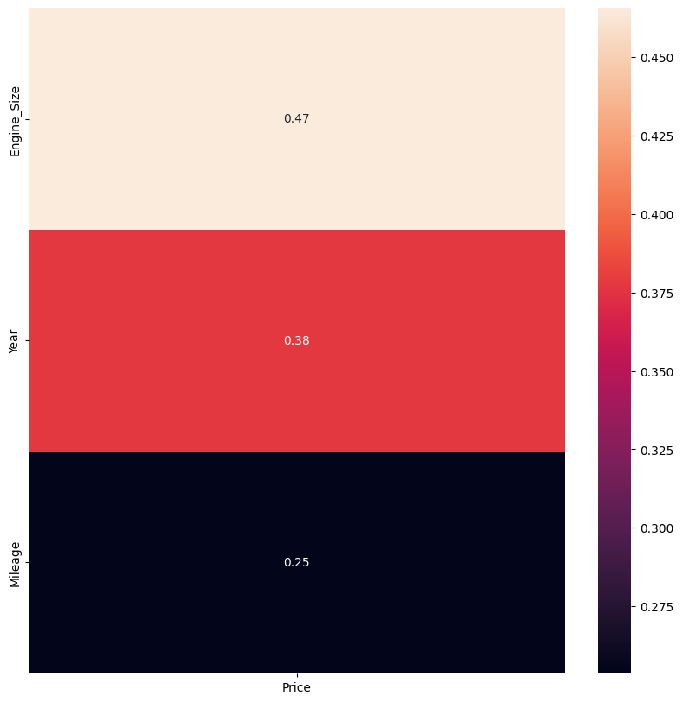
feature selection
The strongest positive correlation with price (0.47). This means that as engine size increases, the price of the car tends to increase as well.
Engine Size
Moderate positive correlation with price (0.38). This means that newer cars (higher year) tend to be more expensive than older cars.
Year
The weakest positive correlation with price (0.25). This means that there is a weak positive relationship between mileage and price. In other words, cars with lower mileage might be slightly more expensive, but the effect is not very strong.
Mileage

Slide 19
3 /
3
MODELLING

Slide 20
3 / Modelling
Feature
Engineering
1
2
3
ENCODING
SCALING
ALGORITHM CHAIN
One Hot encoding for Gear Type, Origin, and Options with less number of unique. Binary encoding for Car Type, Type, Regio, and Make with more number of unique.
Using robust scaler since the data contain outliers. Robust scaler less sensitive to outliers. Scaling for Year, Engine size, and Mileage.
Put the encoding and scaling into Column Transformer.

Slide 21
Bench-
-marking
RANDOM FOREST
XGBOOST REG.
LINEAR REG.
GRADIENT
KNN
MAPE (0.606), R2(0.504)
MAPE (0.31), R2(0.734)
MAPE (0.35), R2(0.737)
MAPE (0.279)
R2 (0.755)
MAPE (0.263)
R2 (0.778)

Slide 22
Tuning
“ Optimize the model performance ”
RANDOMIZED SEARCH CV
GRID SEARCH CV
Randomly samples hyperparameters from a predefined search space.
Creates a grid over the search space and evaluates the model for all possible hyperparameter combinations.
BEST PARAMETER

Slide 23
hyperparameter
sumsample
Proportion of the training data to randomly
sample for each tree.
reg_lambda
L2 regularization term on weights to control overfitting.
reg_alpha
L1 regularization term on weights to control overfitting.
XGBOOST REG.
MAPE (0.263)
R2 (0.778)
n_estimators
Number of trees to fit in the model.

Slide 24
hyperparameter
Minimum sum of instance weight (hessian) needed in a child to avoid overfitting.
min_child_weight
Maximum depth of each tree to control model complexity.
max_depth
Step size shrinkage used to prevent overfitting by updating weights slowly.
learning_rate
XGBOOST REG.
MAPE (0.263)
R2 (0.778)
Minimum loss reduction required to make a further partition on a leaf node.
gamma
Fraction of features to be randomly sampled for each tree.
colsample_bytree

Slide 25
4 /
4
EVALUATION

Slide 26
4 / Evaluation
model
performance
XGBOOST
MAPE
R2 SCORE
XGBoost is based on the gradient boosting framework.
Evaluation using MAPE. Before tuning is 22.6%. Prediction with XGBoost after tuning have error 21.6%.
To know how good model do the prediction. R2 score after tuning 0.812, before tuning 0.786.
Notes:
XGBoost works by building an ensemble of weak learners, which are typically shallow decision trees.
Each decision tree splits the data based on a single feature (e.g., year). The split that best separates high-priced from low-priced cars is chosen.
This process continues recursively, creating a tree-like structure that predicts a price based on the sequence of decisions made while traversing the tree.

Slide 27
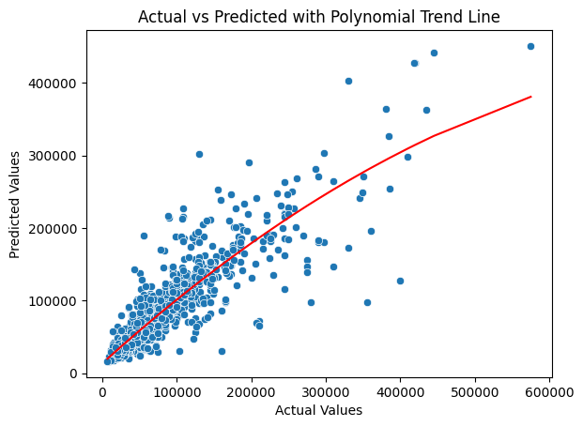
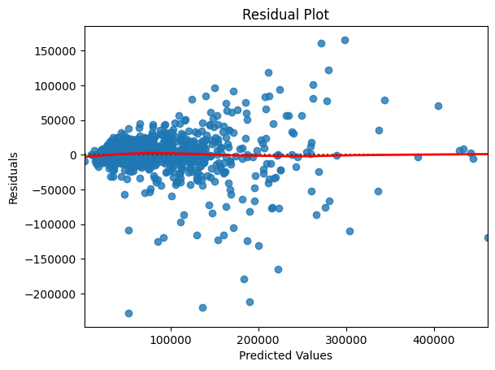
visualize
RESIDUAL PLOT
SCATTER PLOT

Slide 28
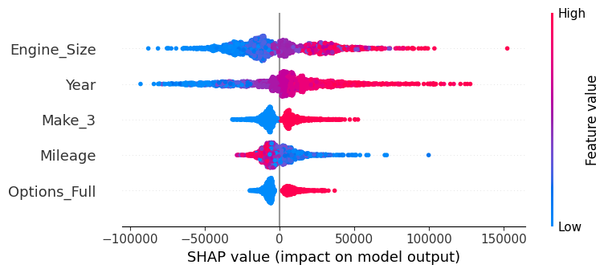
feature importance
EXPLAINABLE AI - SHAP

Slide 29
5 /
5
DEPLOYMENT

Slide 30

5 / Deployment
Google Cloud Platform

Slide 31
6 /
6
OUTPUT

Slide 32
6 / Output
conclusion
CONCLUSION
RECOMMENDATION
Car type and brand were significant predictors of car prices, highlighting their importance in the model.
More data and feature such as service feature. Focus on popular brands. Data driven pricing.

Slide 33
6 / Output
conclusion
MODEL BUSINESS
Scenario : If there is a type and brand of car in the new data with a price of 120,000 SAR and it is sold for 90,000 SAR, the car can be sold for 100,000 SAR using the MAPE model and evaluation metrics. So the revenue gain is 10,000 SAR.

Slide 34


Thank
You!
Rahmad Hadi Syafra Demora
rahasyae

